Slide 1

LI-FI
Presented By:
Poorwa Kumbhaj
142743

Slide 2
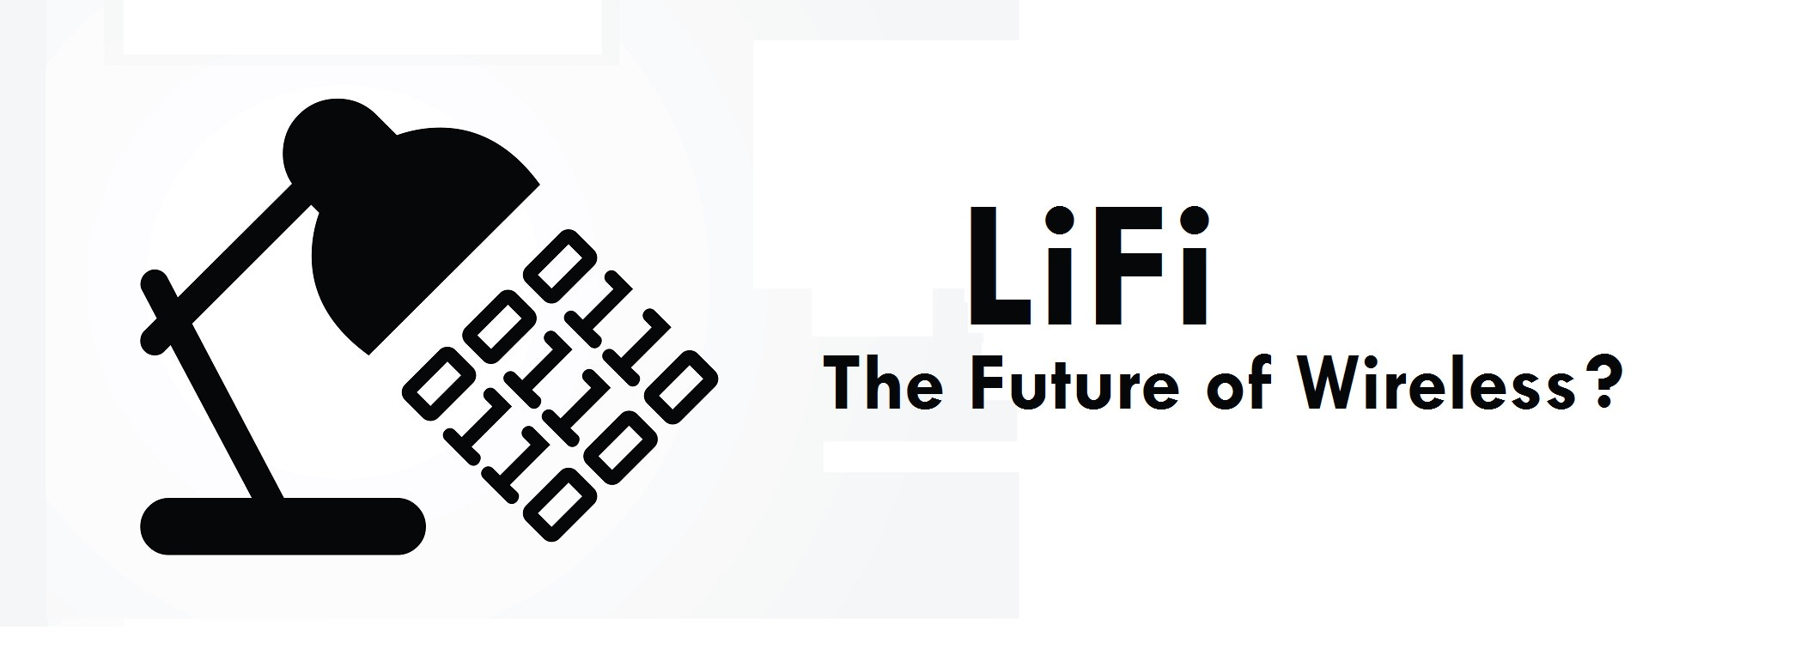
INTRODUCTION
Li-Fi is known as Light Fidelity.
It was introduced by Prof. Harald Haas on July 2011 at TED Global Talk.
Li-Fi is a Visual Light Communication (VLC) system that uses light emitting diodes (LEDs) which runs wireless communications that travel at very high speeds.

Slide 3
HISTORY OF Li-Fi
The technology began during 1990’s in countries like Korea, Japan and Germany where they discovered LED’s to send information.
In October 2011, companies and industry groups formed Li-Fi consortium, to promote high-speed optical wireless system and to overcome the limited amount of radio-based wireless spectrum.
By August 2013, data rates of over 1.6 Gbits were demonstrated over a single color LED.
In October 2013, it was reported that Chinese manufacturers were working on Li-Fi development kits.

Slide 4
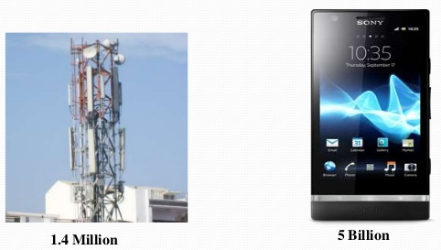
PRESENT SCENARIO
At present we have as many as 1.5 million radio wave base stations across globe.
We also have close to 5 billion mobile connections which transmit a data over 600 TB.
This penetration of mobile devices into our lives has led to a wide recognition of Wi-Fi technology.
Radio spectrum is congested but the demand for wireless data gets double every year.
Everyone wants to use wireless data but the capacity is drying up.

Slide 5
Issues Regarding Radio Spectrum
Capacity
Radiowaves
Cost and expensive
Less bandwidth compared to other spectrums
Insufficient spectrum for increasing data
Efficiency
Millions of base stations consume huge amount of energy for transmitting the radio waves and to cool the base station cabins
5% efficiency

Slide 6
Availability
Available within the range of base stations
Limited availability
Unavailable in aircrafts
Security
Less secure (passes through the walls)

Slide 7
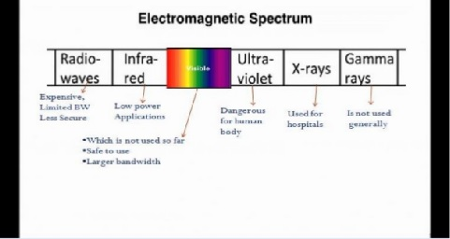
Why VLC?
Gamma rays cannot be used as they could be dangerous.
X-Rays are used in hospitals.
Ultraviolet light is good for place without people, otherwise dangerous for the human body.
Due to eye safety, IR can only be used with low power.

Slide 8
Working Process
Operational procedure is very simple. If LED is on, you transmit a digital 1, if it is off then digital 0.
The LEDs can be switched on and off very quickly which gives nice opportunities for transmitting the data.
Hence all that is required is LEDs and a controller that code data into those LEDs. We have to just vary the rate at which the LEDs flicker depending on the data we want to encode.
Every light source will work as a hub for data transmission..

Slide 9
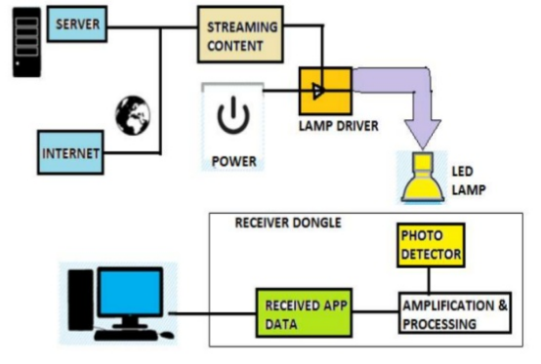
How Li-Fi Works?
Li-Fi technology consist of LED Lamp as the media transmission and photo detector as a receiver of transmitted data. Lamp driver is needed to make LED working properly. While amplification and processing are responsible to manage the signal that comes from the photo detector.
On one end all the data on the internet will be streamed to the lamp driver when LED is turned on the microchip converts the digital data in form of light.
Photodetector receives the signal and converts it back into the original data. This method of using rapid pulses of light to transmit information wirelessly is known as Visible Light Communication (VLC).

Slide 10
Li-Fi Vs Wi-Fi
Li-Fi can be thought of as a light based Wi-Fi. That is, it uses light instead of radio waves to transmit information.
Instead of Wi-Fi modems, Li-Fi would use transceiver fitted LED lamps that can light a room as well as transmit and receive information.
Wi-Fi is great for general wireless coverage within buildings and Li-Fi is ideal for high density wireless data coverage in confined areas.

Slide 11
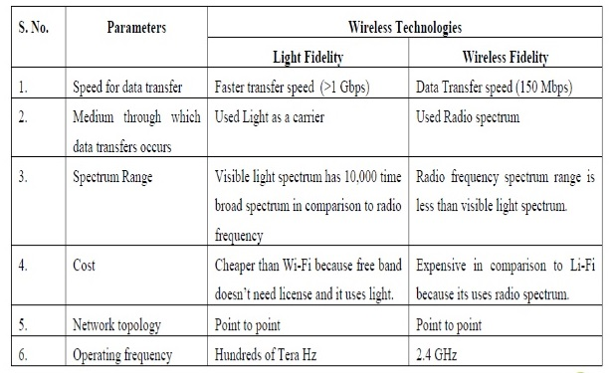

Slide 12
Limitations And Challenges
Light cannot pass through objects.
Li-Fi requires the light bulb is on at all the time to provide connectivity, meaning that the light will need to be on during the day.
Interferences from external light source like sunlight, normal bulbs and opaque materials in the path of transmission will cause interruption in the communication.
Li-Fi requires line of sight.
High installation cost of the VLS system.
Major challenge of Li-Fi is how the receiving device will transmit back to transmitter.

Slide 13
Applications
Traffic Lights
Traffic Lights can communicate to the car and with each other. Cars have LED based headlights and backlights and cars can communicate with each other and prevent accidents by exchanging information.
Safe Environment
Visible light is more safe than RF, hence it can be used at places where RF cannot be used such as petrochemical plants.
Airlines
Whenever we travel in airways we face problem in communication media because whole airways communication is performed on the basis of radio waves.
On Ocean Beds
Li-Fi can even work under water where Wi-Fi completely fails. Therefore, Li-Fi can be used in military and navigation operations.

Slide 14
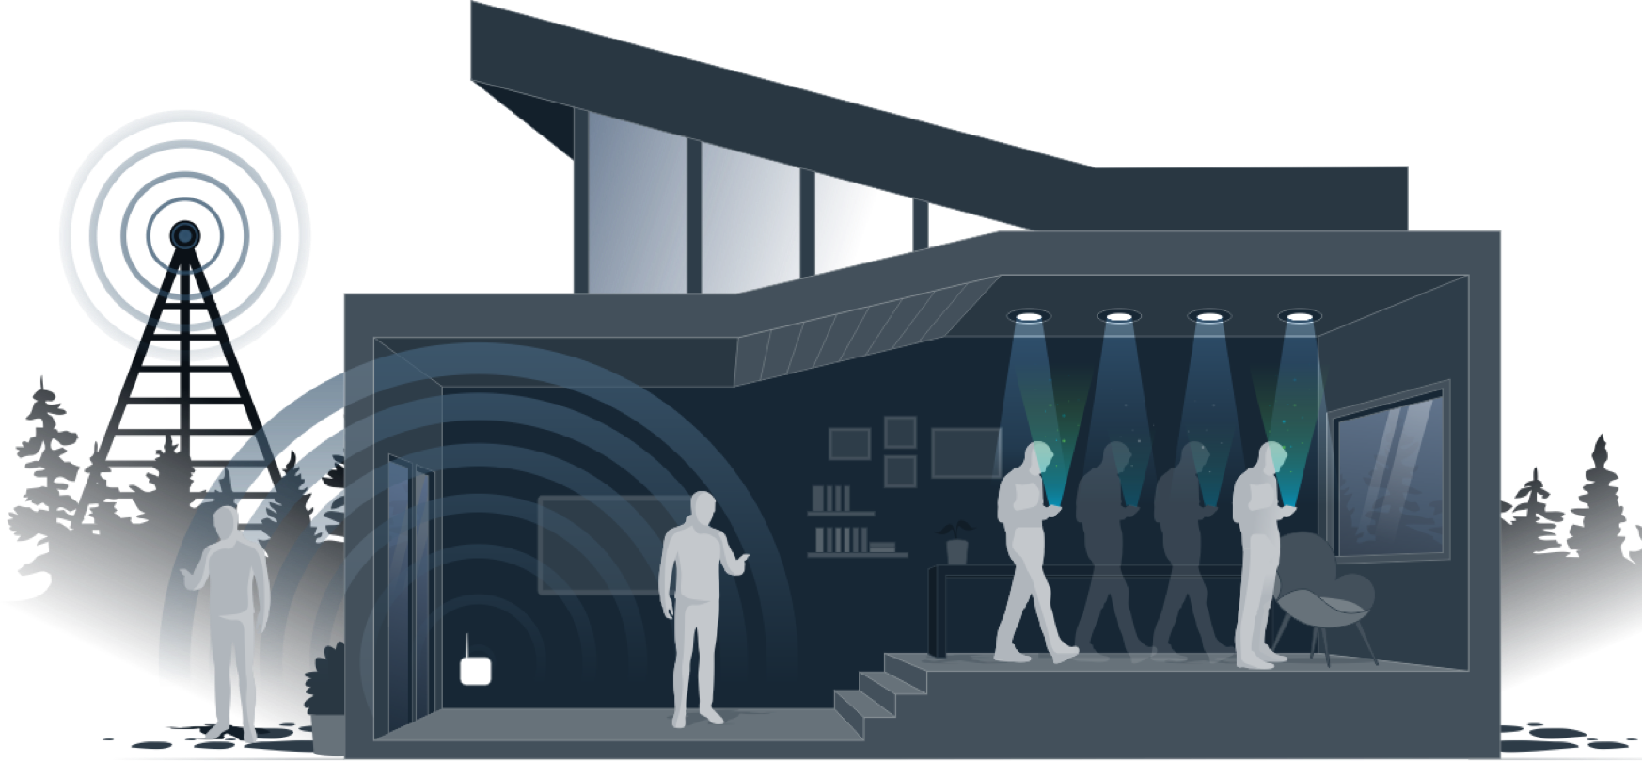
Conclusion
The possibilities are numerous and can be explored further. If this technology can be put into practical use, every bulb can be used as a Wi-Fi hotspots to transmit wireless data.

